Slide 1
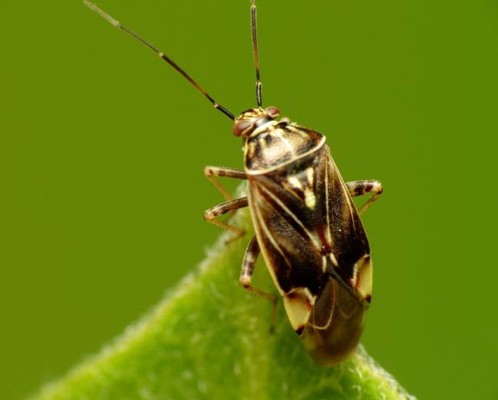

Alfalfa Perimeter Strips Reduce Tarnished Plant Bug Populations in June-Bearing Strawberry Fields
Matt Hetherington and Christelle Guédot

Slide 2
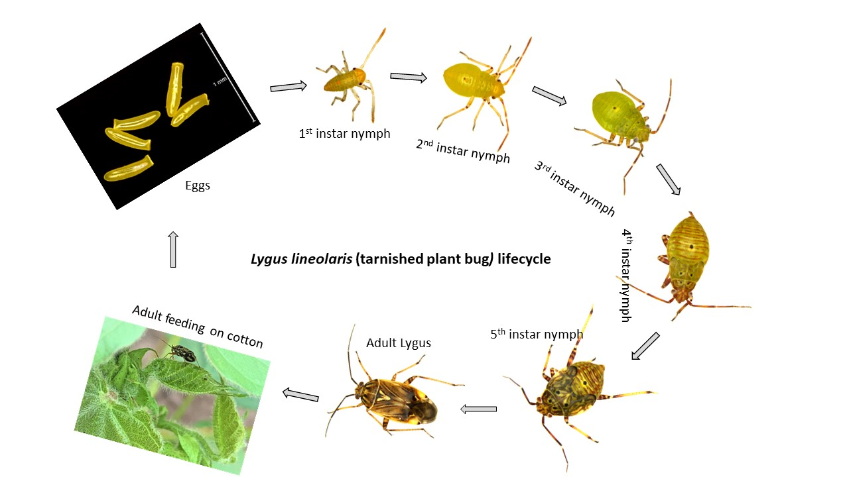
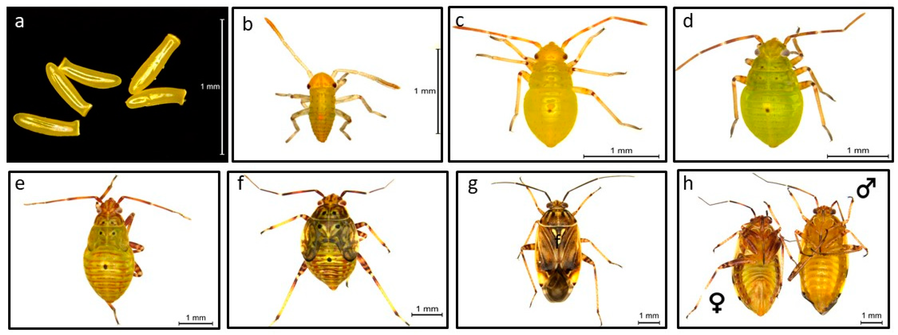
Lygus Bugs
Present throughout WI
Lygus lineolaris (tarnished plant bug) most prevalent
Nymphs have 5 dorsal spots
George J, Glover JP, Gore J, Crow WD, Reddy GVP. Insects. 2021; 12(9):807. https://doi.org/10.3390/insects12090807

Slide 3
Seasonality
Overwintering adults are active in spring when temperatures exceed 49° F
Populations grow on spring weeds
Move into strawberry around blossom
  Populations persist throughout season

Slide 4
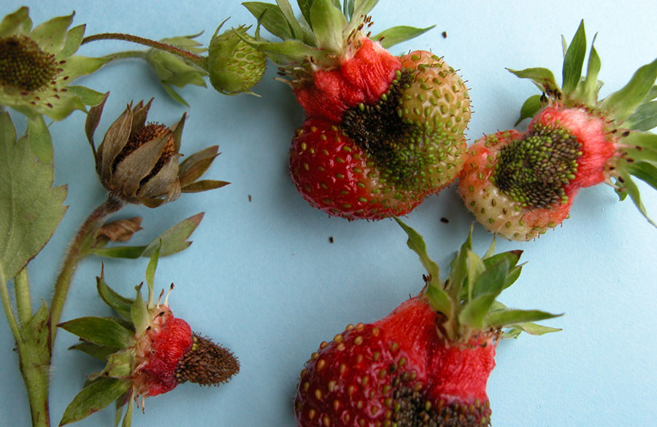
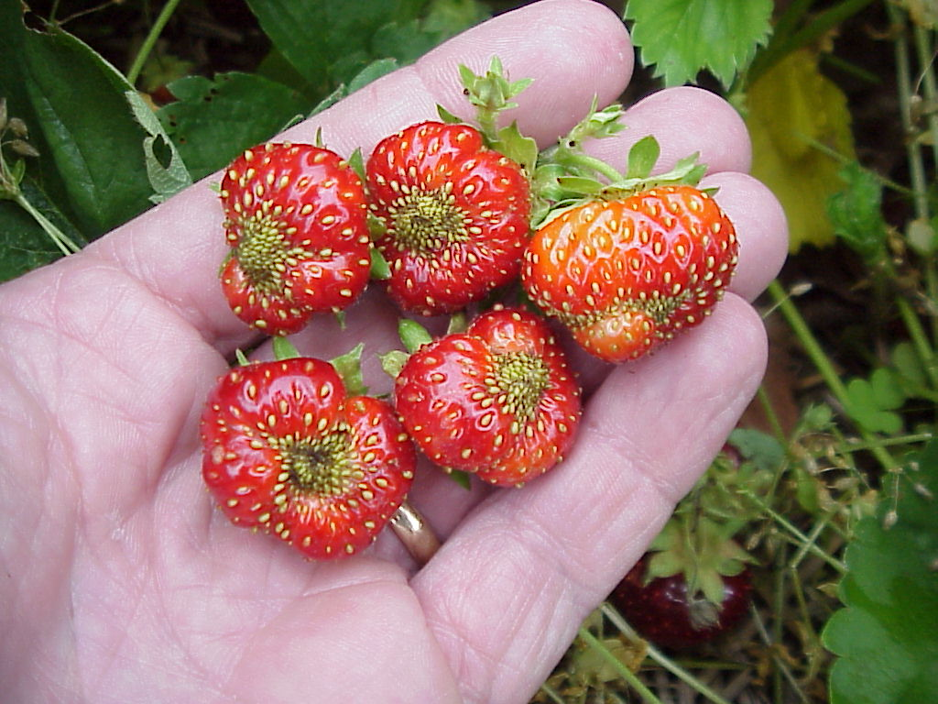
Damage
Frost
Feed on buds, flowers, and fruit causing fruit malformation (‘catfacing’) and apical seediness
Often damage entire cluster
TPB

Slide 5
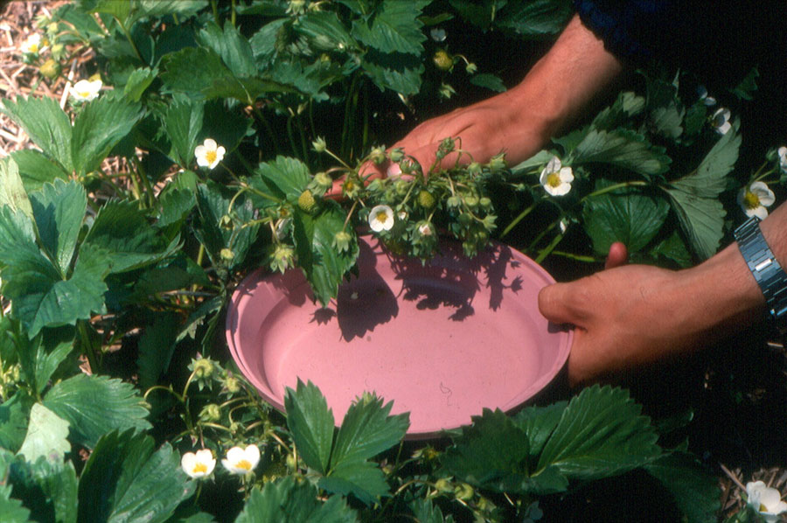
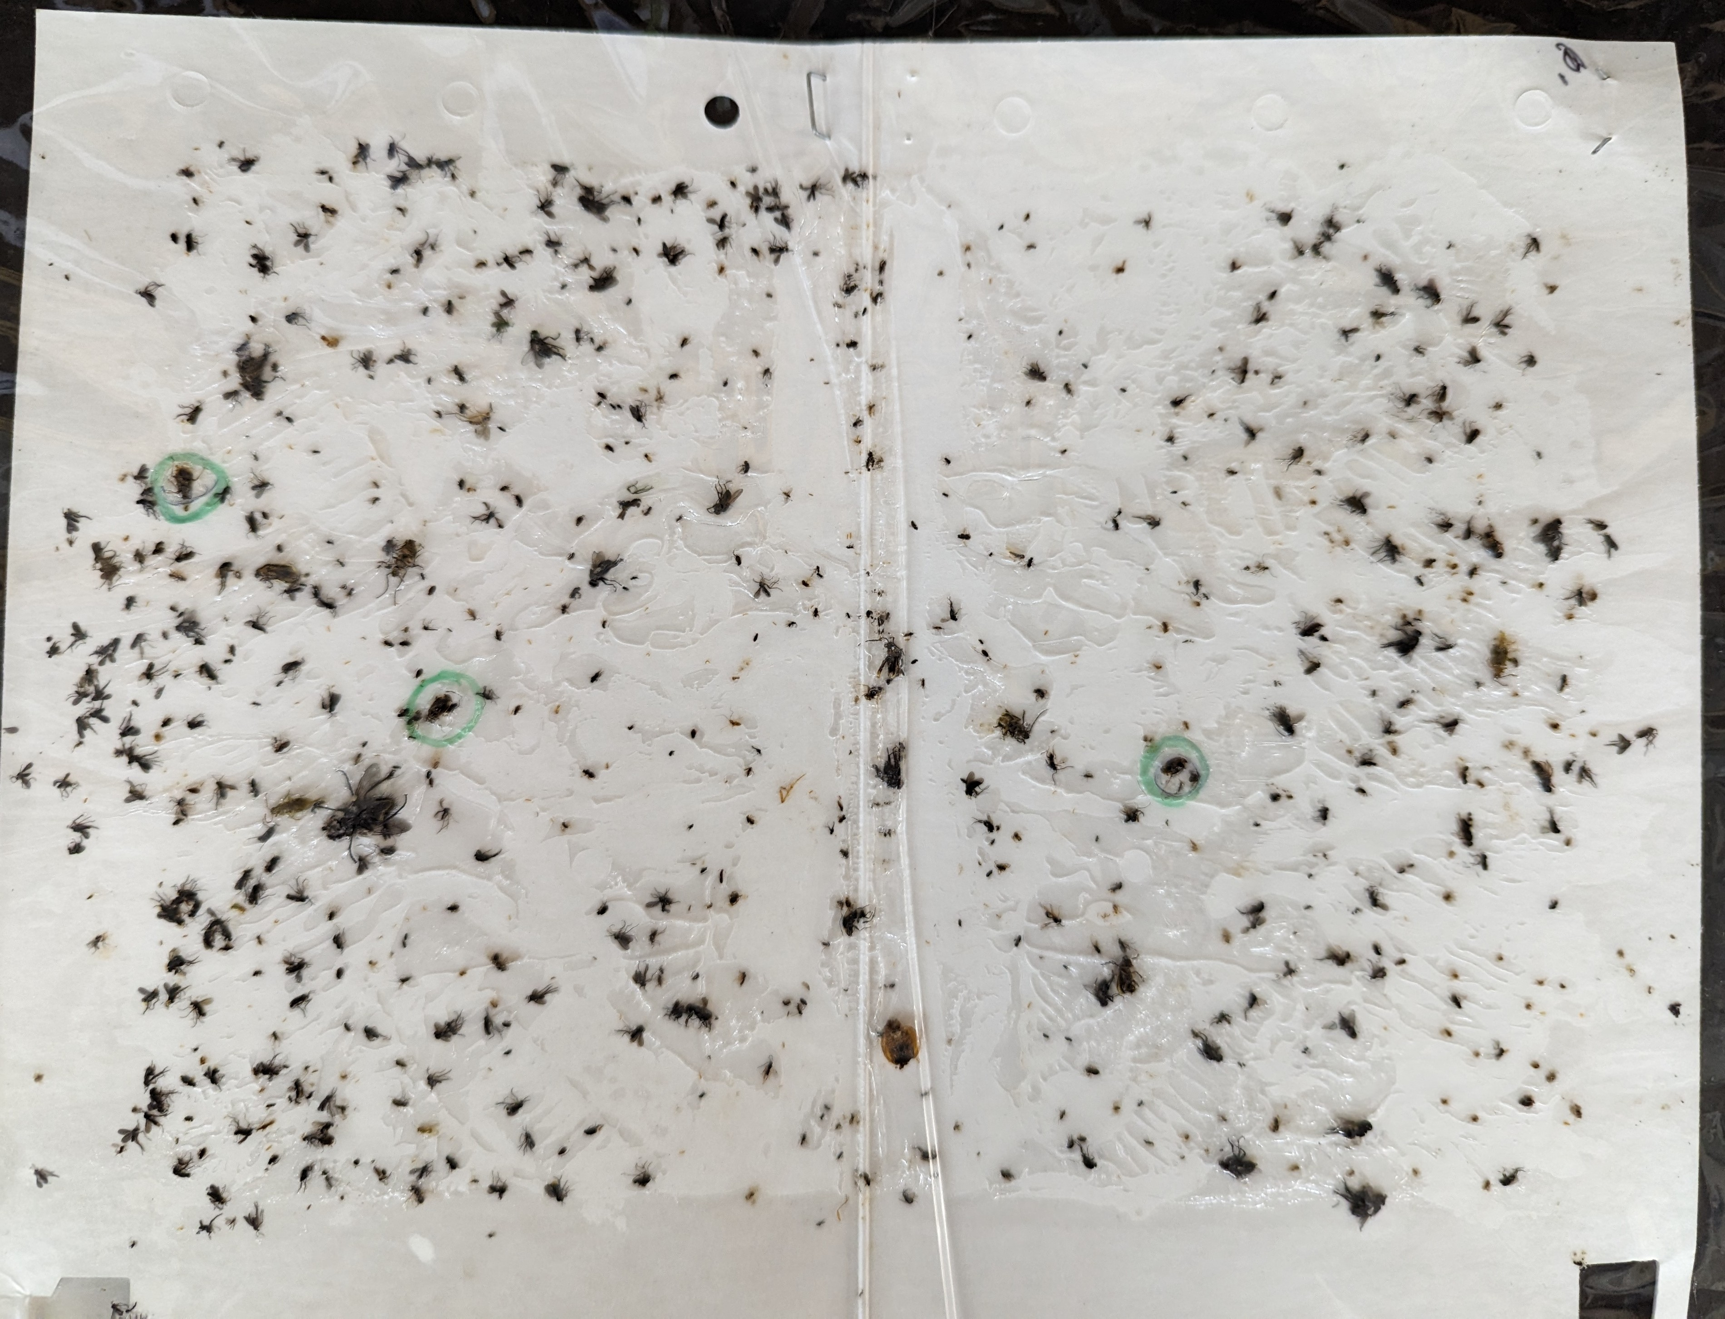
Monitoring and Managing Lygus
Sweep sampling (pre-bloom) – Threshold: 4 adults/20 sweeps
Tapping flowers – Threshold: 1 insect/1-4 clusters
Sticky traps for monitoring movement
White currently standard
Other colors may be better^{1,2}
1. Wold and Hutchison, 2003, Journal of Economic Entomology
2. Legrande and Los, 2003, Florida Entomologist

Slide 6
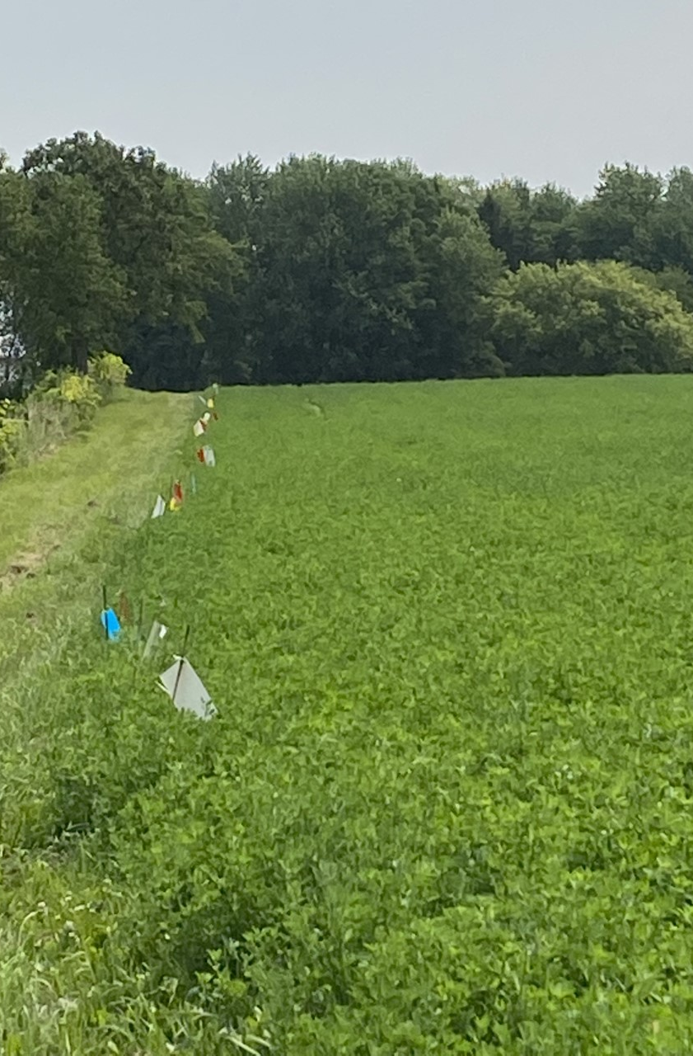
TPB Color Preference
Compared capture of TPB across Red, White, Blue, Yellow and Clear sticky cards
10 complete randomized blocks
2 week-long sampling periods in late-July and late-August

Slide 7
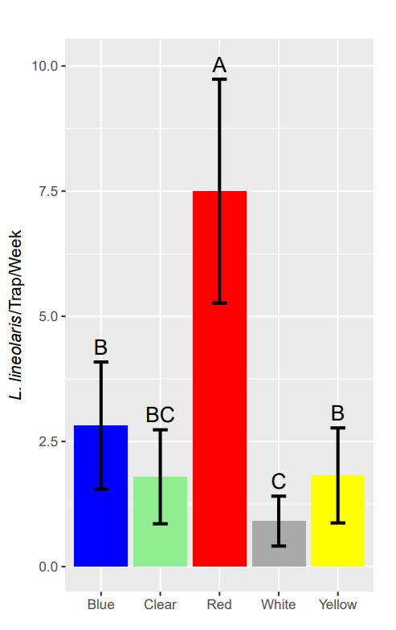
TPB Color Preference
Red sticky cards caught 733% more TPB than white traps
White traps marketed for TPB monitoring performed worst

Slide 8
Chemical Control

Slide 9
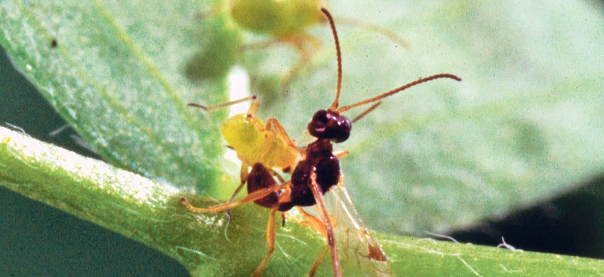
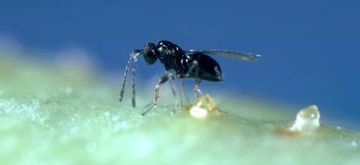
Biological Control
8-10 Native parasitoids
Peristenus digoneutis
  Introduced in the 1980s
  Not yet observed in Wisconsin
Generalist predators

Slide 10
Cultural Control
Control broadleaf weeds early
Avoid mowing weeds during bud swell, bloom, or early fruit set
Trap crops?

Slide 11
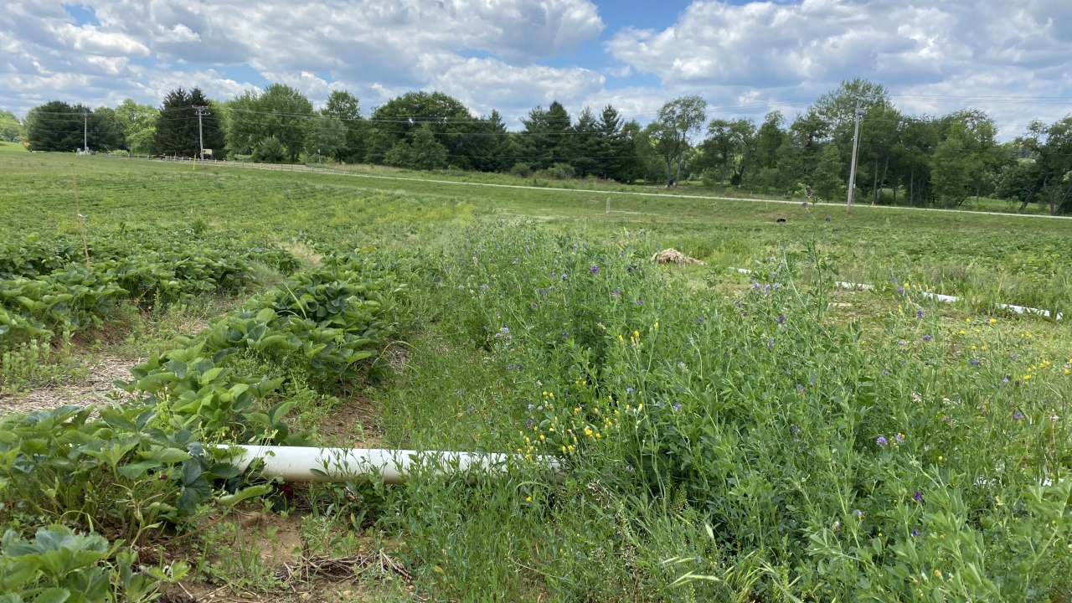
Trap Cropping
Trap crops are plant stands that are deployed to attract, divert, intercept, and/or retain targeted insects or the pathogens they vector in order to reduce damage to the main crop.

Slide 12
Trap Cropping
TPB populations tend to be high in alfalfa early in the season in the Midwest.
Alfalfa trap cropping has shown promise with other Lygus species in California and Europe.
Has not been tested for TPB.

Slide 13
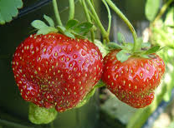
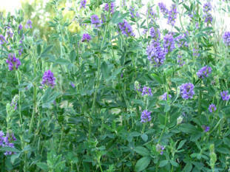
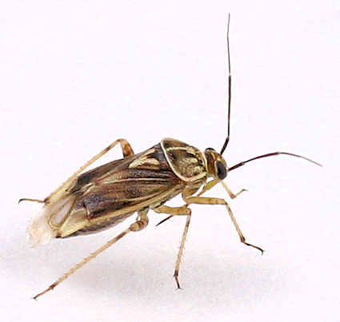
Hypothesis
TPB exhibits a preference for alfalfa and this preference can be exploited to improve management in Wisconsin

Slide 14
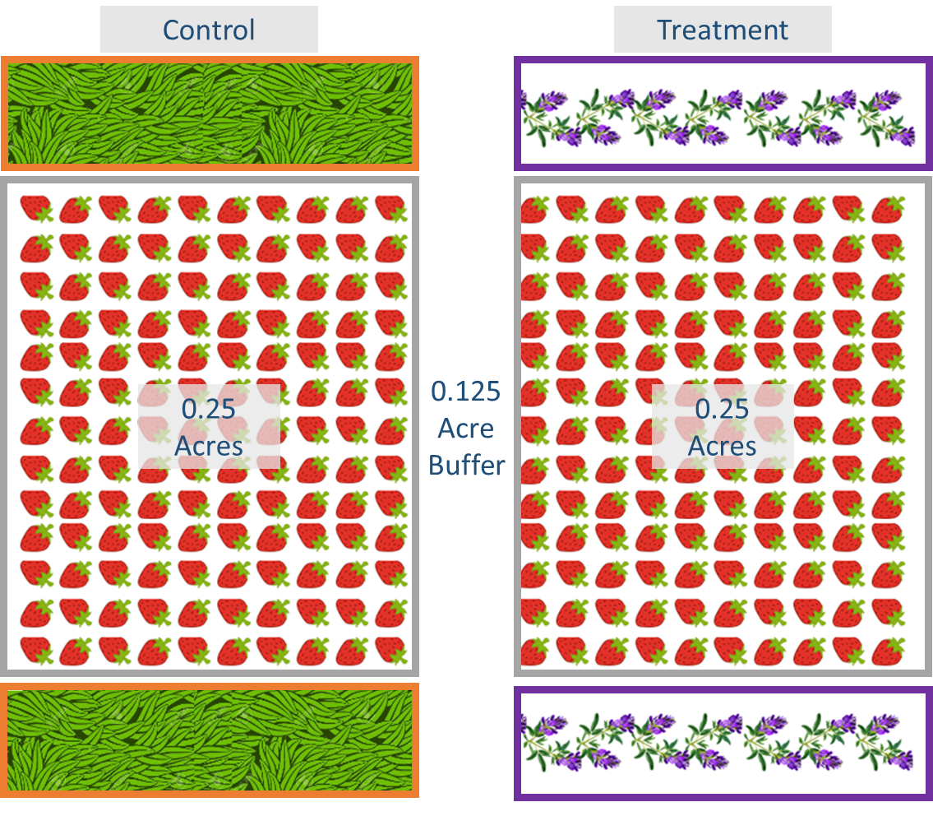
Plot Layout
0.25-acre paired strawberry plots
Separated by 0.125-acre buffers
Treatment = 0.5m strip of alfalfa

Slide 15
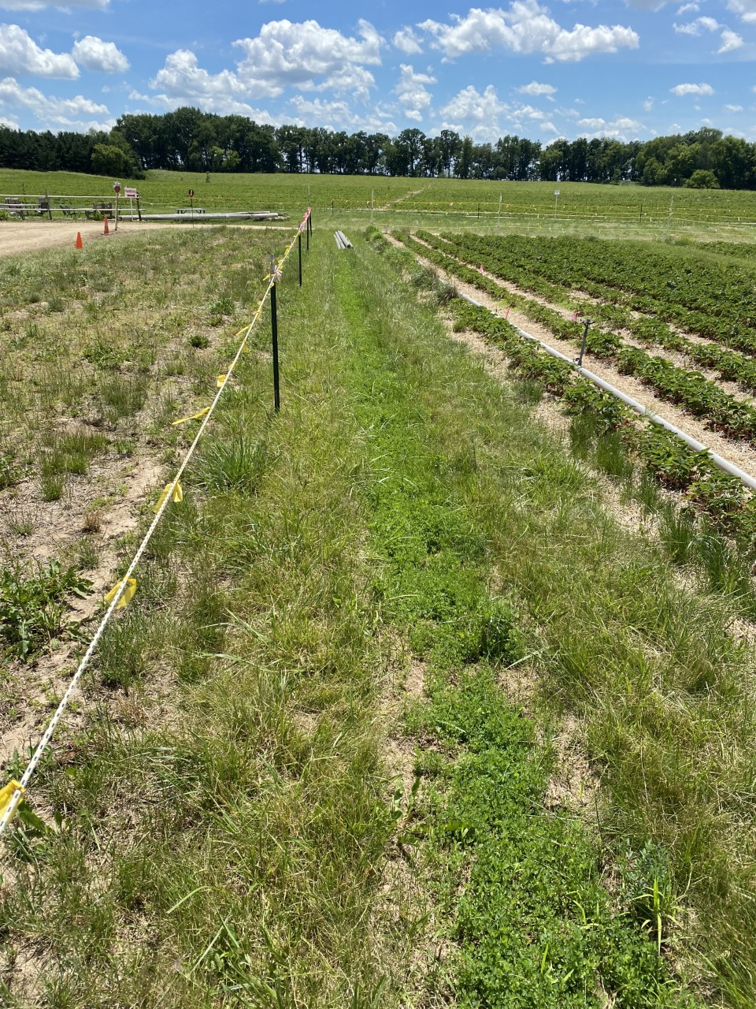
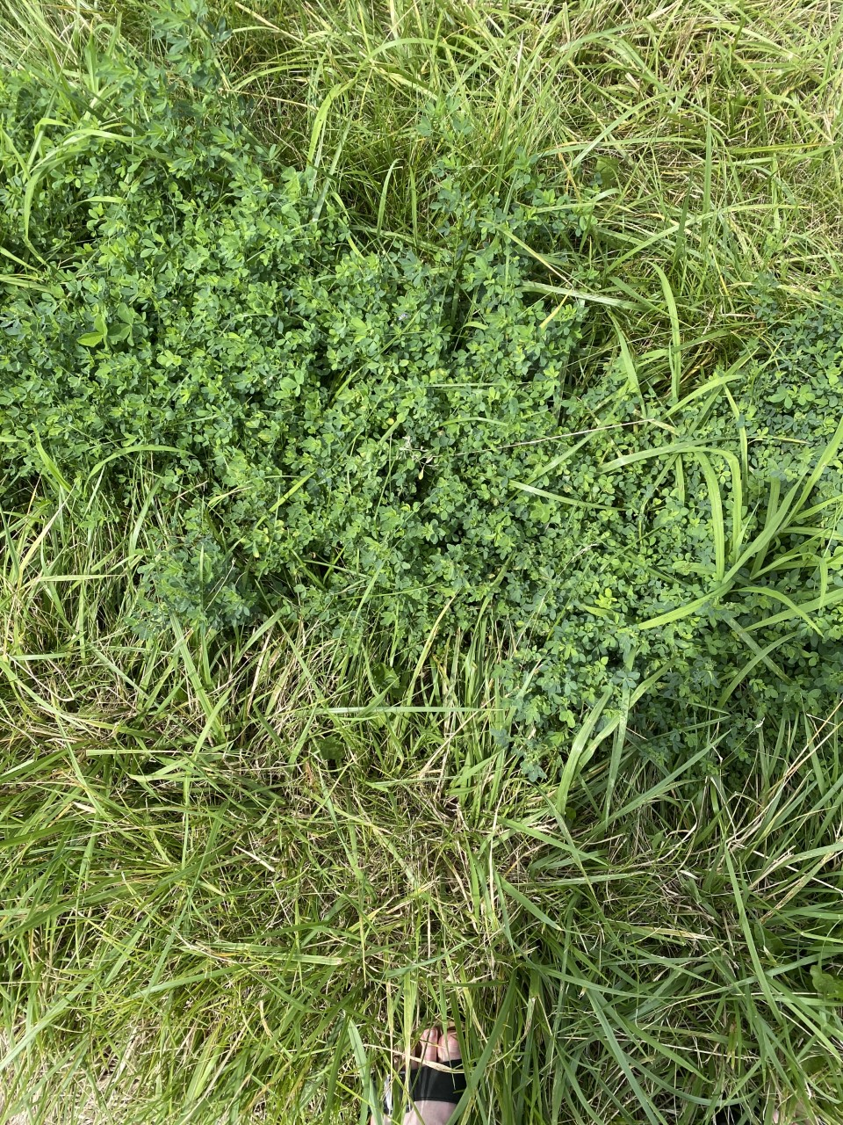
Plot Establishment
Transplanted mature alfalfa plants every 0.3m
Seeded strip interior
3 farms in South WI

Slide 16
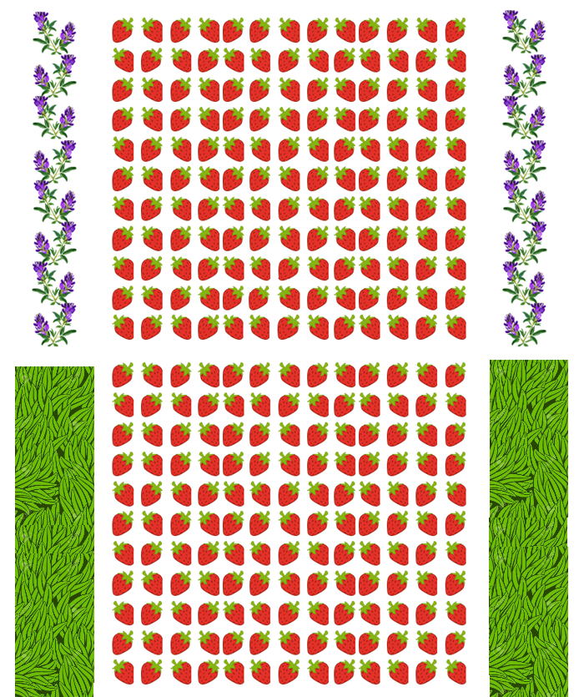
Sampling
10m
Weekly sampling (May-July)
20 sweeps from the centermost 10m of each row
  Perimeter Row
  Strawberry 1, 2, 3, and 10
Clear sticky cards and Pitfall traps
  Perimeter
  Rows 2 and 10
1
2
3
…
10
10
…
3
2
1
10m

Slide 17


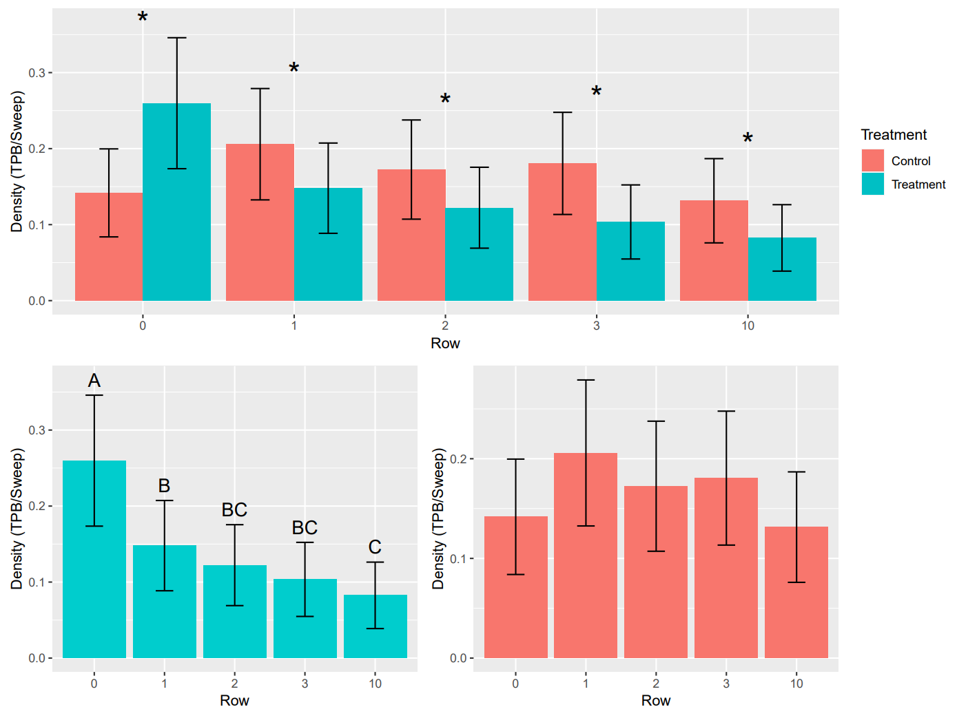
TPB Density
TPB density was significantly reduced in all trap cropped strawberry rows compared to control
TPB density significantly higher in alfalfa compared to strawberry
No differences within control plots

Slide 18
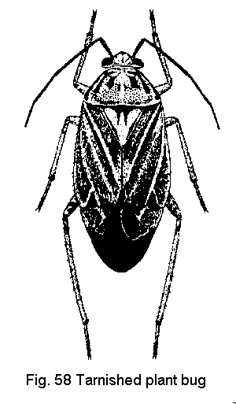
Movement between strawberry and alfalfa
Alfalfa is a high-quality TPB host and may become a source of infestation.
We conducted an experiment to assess the extent and direction of movement between alfalfa strips and adjacent strawberries.

Slide 19
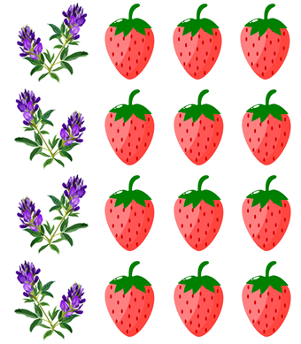
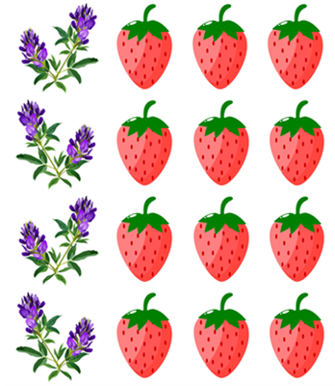
Movement between strawberry and alfalfa
Ovalbumin
Casein
Ovalbumin
Non-fat milk (casein) applied to 3 strawberry edge rows
25% egg white (ovalbumin) solution applied to the alfalfa strips
Insects were marked with proteins during spraying or via contact with sprayed vegetation

Slide 20
Enzyme-Linked Immunosorbant Assay
Ovalbumin
Casein
Ovalbumin
Insects collected 36 hours after markers applied
TPB were sorted and rinsed to extract protein markers
Marker proteins were detected via colorimetric antibody assay
Casein-marked insects in alfalfa moved from strawberry
Ovalbumin-marked insects in strawberry moved from alfalfa
?
?
?
?

Slide 21
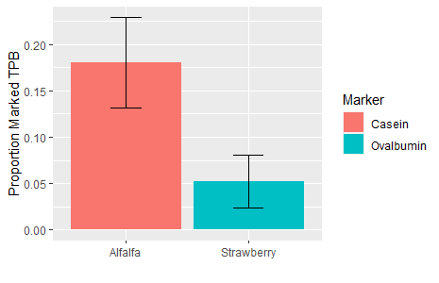
TPB Movement
Χ² = 6.20, p = 0.013
Insects originating in strawberry represented a significantly higher proportion of the population in alfalfa than insects originating from alfalfa in adjacent strawberry plots.
Net movement towards alfalfa

Slide 22
Conclusions
Red sticky cards are more useful than white for monitoring TPB populations
Alfalfa perimeter plantings reduced TPB populations in strawberry fields by ~40% between 2020 and 2022.
Net movement into alfalfa from strawberry suggests alfalfa strips are sinks for TPB in June-bearing strawberries

Slide 23
Implementing Alfalfa Trap Cropping
1-1.5m-wide strips of alfalfa (40-60in)
~1m away from your strawberry field
Cut half of the strip (alternating) every 14-17 days from bloom-harvest to reduce TPB population

Slide 24

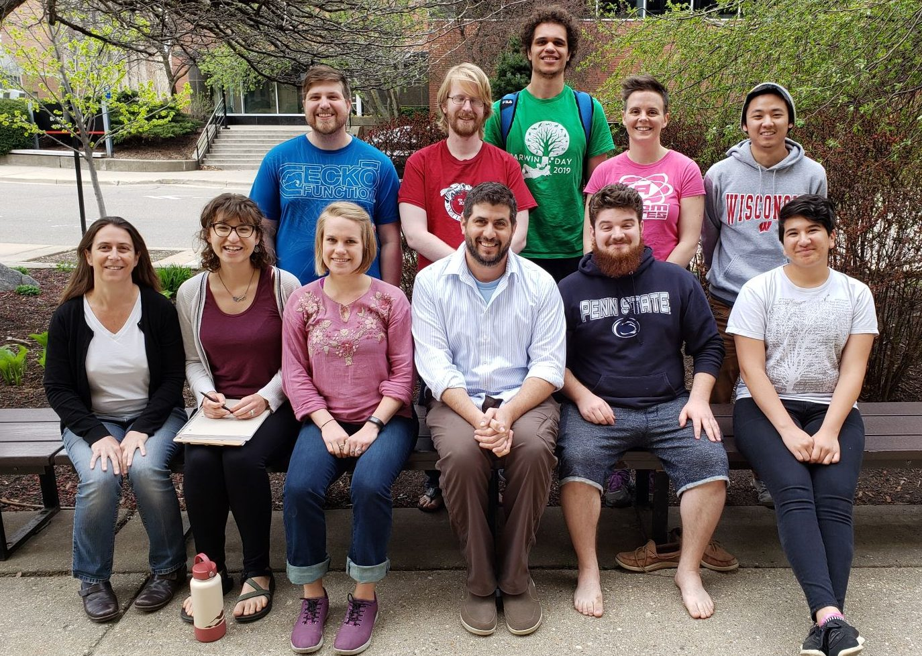
Acknowledgements
Our grower partners
Fruit Crop Entomology Lab
Undergraduate Assistants:
  Emma Mechelke, Matt Fox, Megan Johnson, Aja Hodge Kelsick, Morgan Weissner, and Allison Lopina
Funding: NCR-SARE LNC20-436
Lillian and Alex Feir Wisconsin Distinguished Fellowship in Entomology

Slide 25
